Slide 1

Distance Sensor
IEEEngage
Gantabya Kadel

Slide 2
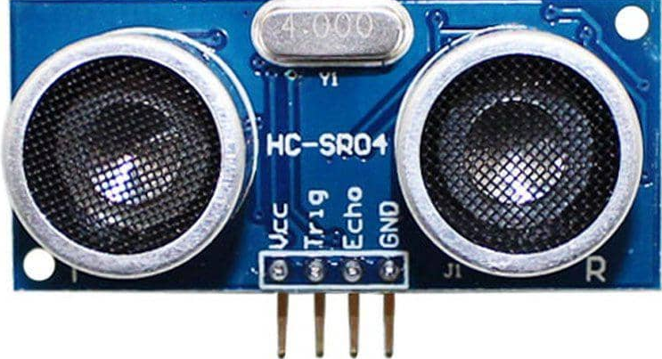
HC-SR04
Ultra Sonic Distance Sensor
Simple Easy To Use
Provides 2 [cm] – 400 [cm] non-contact measurement function
Ranging accuracy can reach to 3 [mm]
Module includes
Ultrasonic Transmitters
Ultrasonic Receiver
Control Circuit
Principles of Operation:
IO triggers of at least 10 [us] high level signal.
Module sends 8 40 [kHz]
Detect whether there is a pulse signal back
Usually Infrared Distance Sensor in Course work
Works better with CCS via the ADC Module

Slide 3
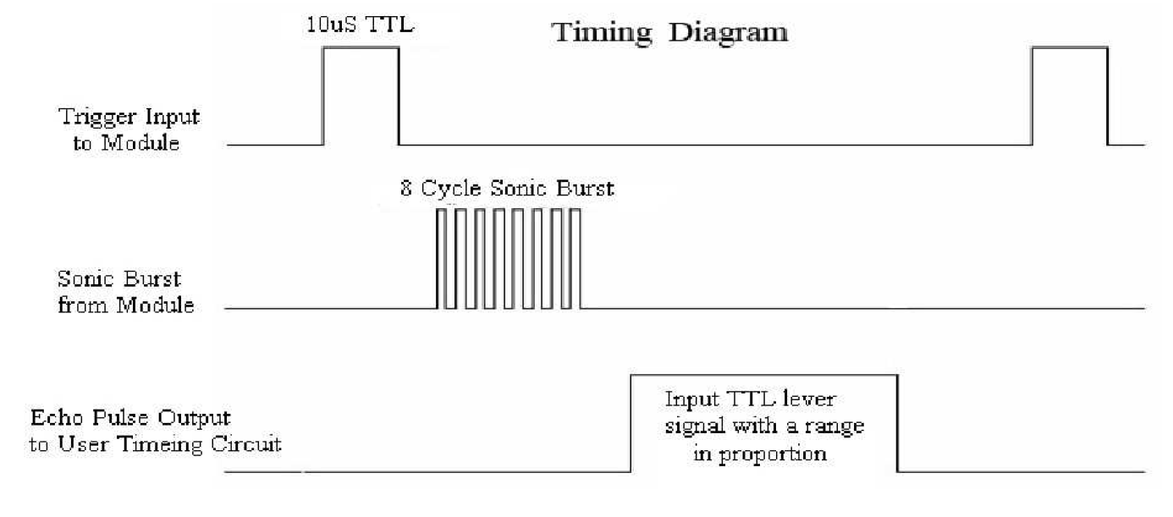
Timing Diagram of HC-SR04

Slide 4
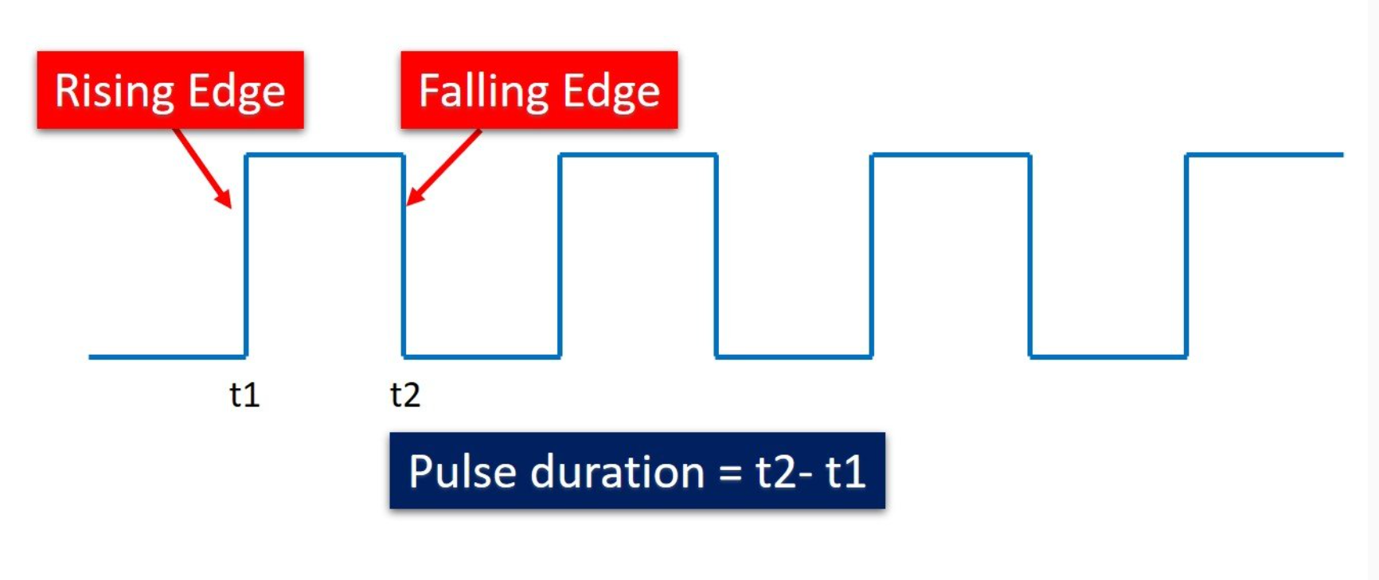
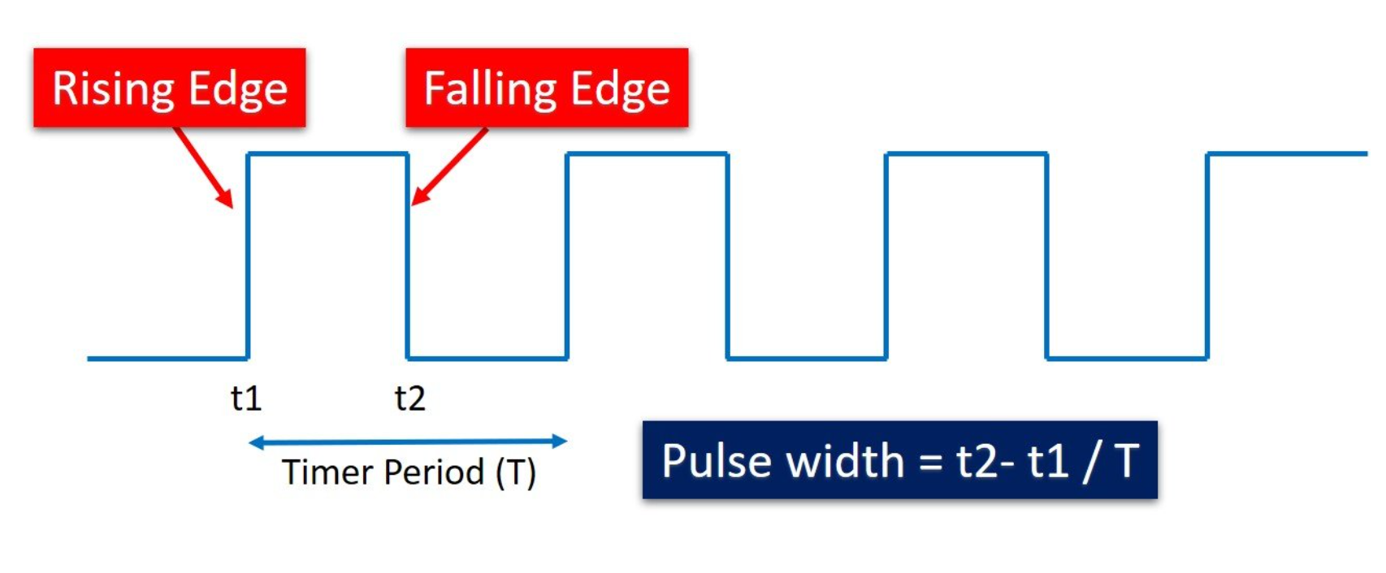
How To Use Here
Measuring time difference between the rising & falling edge
Measure pulse width or duration
Capture & Save Rising Edge Time
Can Find Pulse Width if Period is Known
Energeia Code Now
Formula To Covert Dist into cm:
uS/ 58
uS = pulse duration
Formula To Convert Dist into inch:
uS/ 148

Slide 5
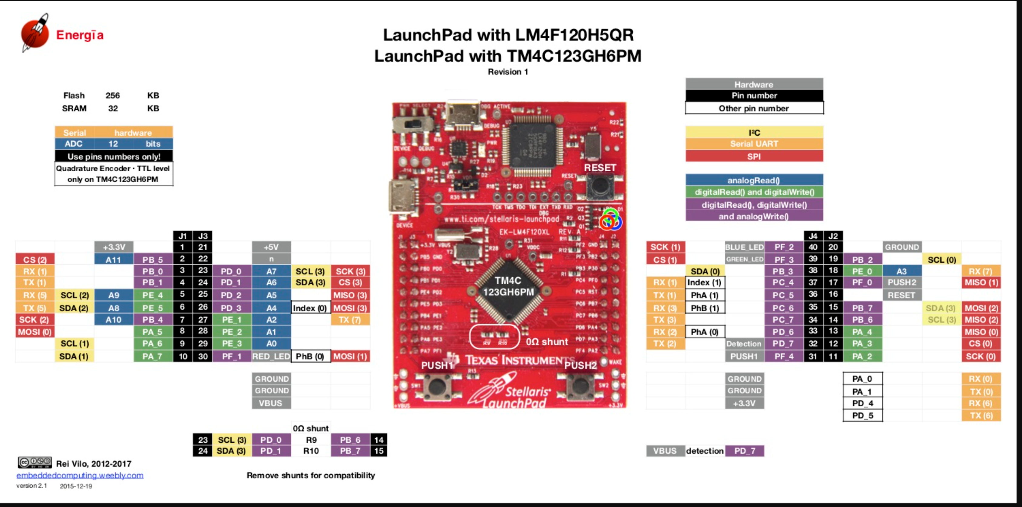
Pin Map

